Slide 1
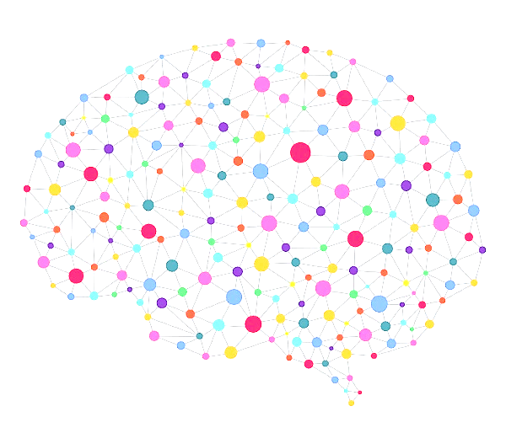

Adama Science & Technology University
School of Electrical Engineering and Computing Department of Computer Science and Engineering
October 2020
Adama, Ethiopia

Slide 2

Kirubel Abebe
Title:
Temporal Cycle consistency: for a video to video translation.
By:
Kirubel Abebe Senbeto
Advisor:
Prof. Yun Koo Chung
Adama Science and technology University
October, 2020

Slide 3
Title: “Temporal Cycle Consistency: for a video to video translation.” MSc Thesis presentation.
MSc Thesis presentation
Kirubel Abebe Senbeto
Prof. Yun Koo Chung

Slide 4
01
02
03
04
Introduction
Motivation
Statement of the Problem
Temporal Cycle consistency:
Objectives
for a video to video translation
05
Scope And Limitation
06
Literature Review
07
Methodology and Proposed Work
08
Result, and Discussion
09
Conclusion and future work

Slide 5
Outlines
Introduction
Literature review
Methodology
Proposed work
Result, and Discussion
Conclusion & future work
Temporal Cycle consistency:
for a video to video translation

Slide 6
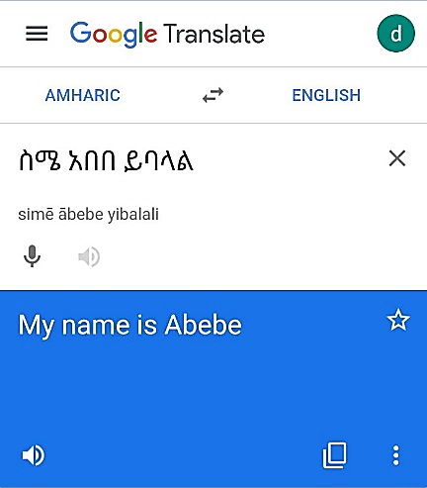
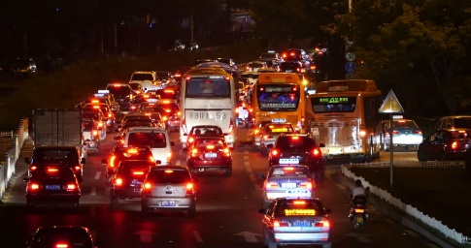
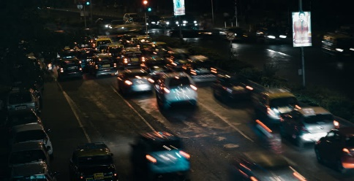
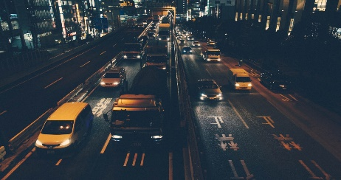
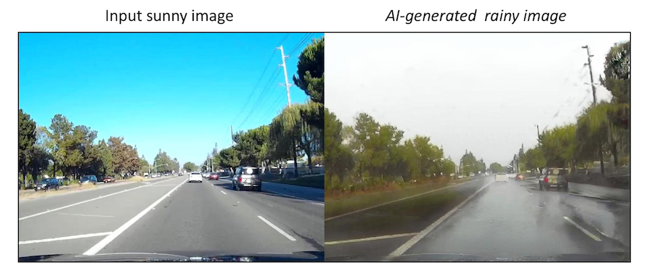

Slide 8


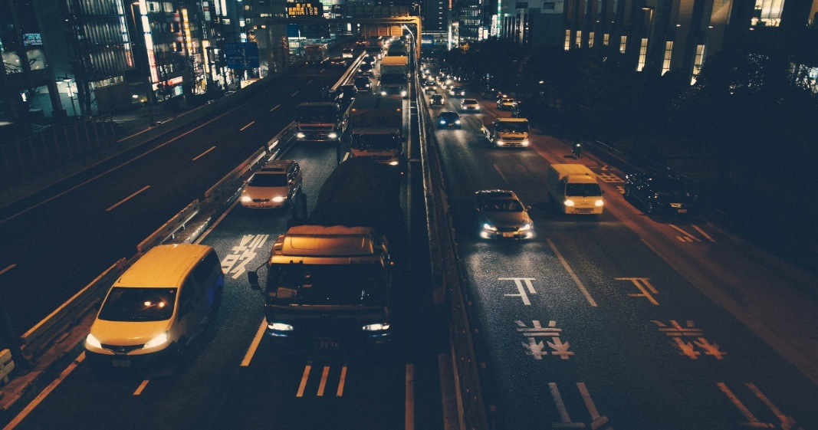

Slide 9
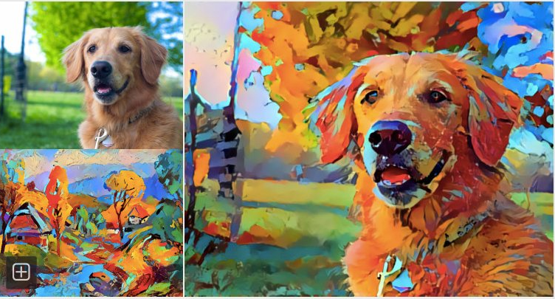
Introduction
Source
Content Translation: transferring of content information form one domain to another.
While preserving the content of source domain and style of the target domain .
Style

Slide 10
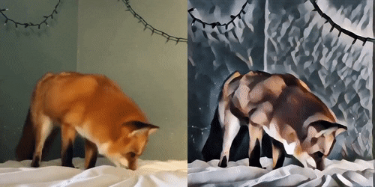
Introduction
Video translation: is a class of vision and graphics problems where the goal is to learn the mapping between an input video and an output video.

Slide 11
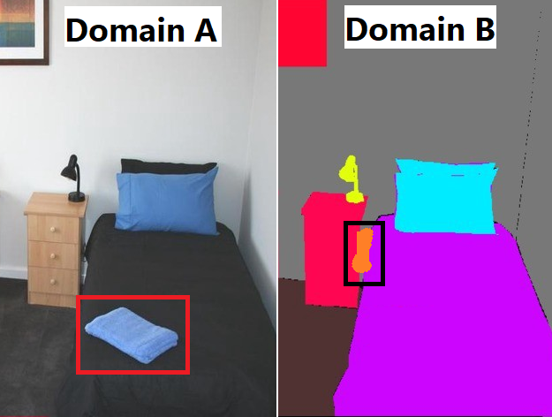
Motivation
Translated Video
Should preserve content
Object disappearance.
Should have realistic motion
Arbitrary strange motion on the generated (flickering).
Notes:
However, currently used video-to-video translation networks, prone to object disappearance
problems, and arbitrary strange motion on the generated videos make translated videos more
unrealistic.

Slide 12
Motivation
Translated Video
Should preserve content
Object disappearance.
Should have realistic motion
Arbitrary strange motion on the generated (flickering).
Notes:
However, currently used video-to-video translation networks, prone to object disappearance
problems, and arbitrary strange motion on the generated videos make translated videos more
unrealistic.

Slide 13
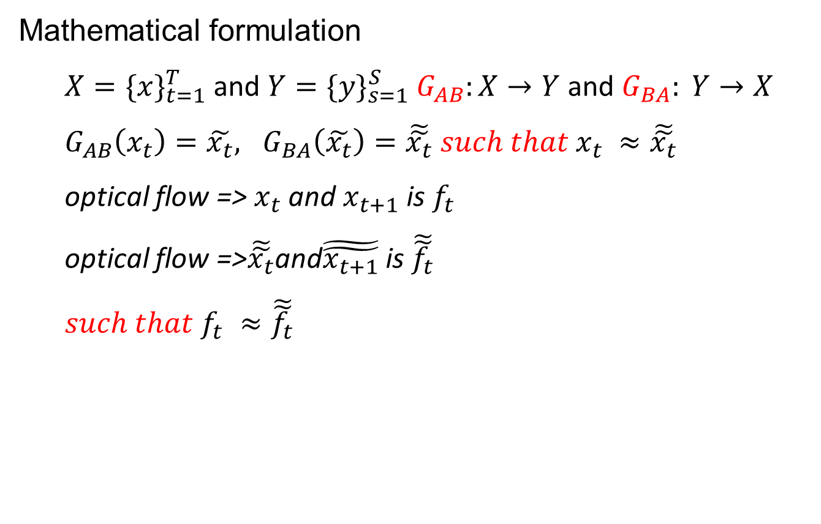
Statement of the problem
Mathematical formulation
$X=\{x\}_{t=1}^{T}$ and $Y=\{y\}_{s=1}^{S} G_{AB}:X→Y$ and $G_{BA}: Y→X$
$G_{AB}\left(x_{t}\right)=\tilde{x_{t}}, G_{BA}\left(\tilde{x_{t}}\right)=\tilde{\tilde{x_{t}}} such that$ $x_{t} ≈\tilde{\tilde{x_{t}}}$
optical flow => $x_{t}$ and $x_{t+1}$ is $f_{t}$
optical flow =>$\tilde{\tilde{x_{t}}}$and$\tilde{\tilde{x_{t+1}}}$ is $\tilde{\tilde{f_{t}}}$
$such that$ $f_{t} ≈\tilde{\tilde{f_{t}}}$
Notes:
However, currently used video-to-video translation networks, prone to object disappearance
problems, and arbitrary strange motion on the generated videos make translated videos more
unrealistic.

Slide 14
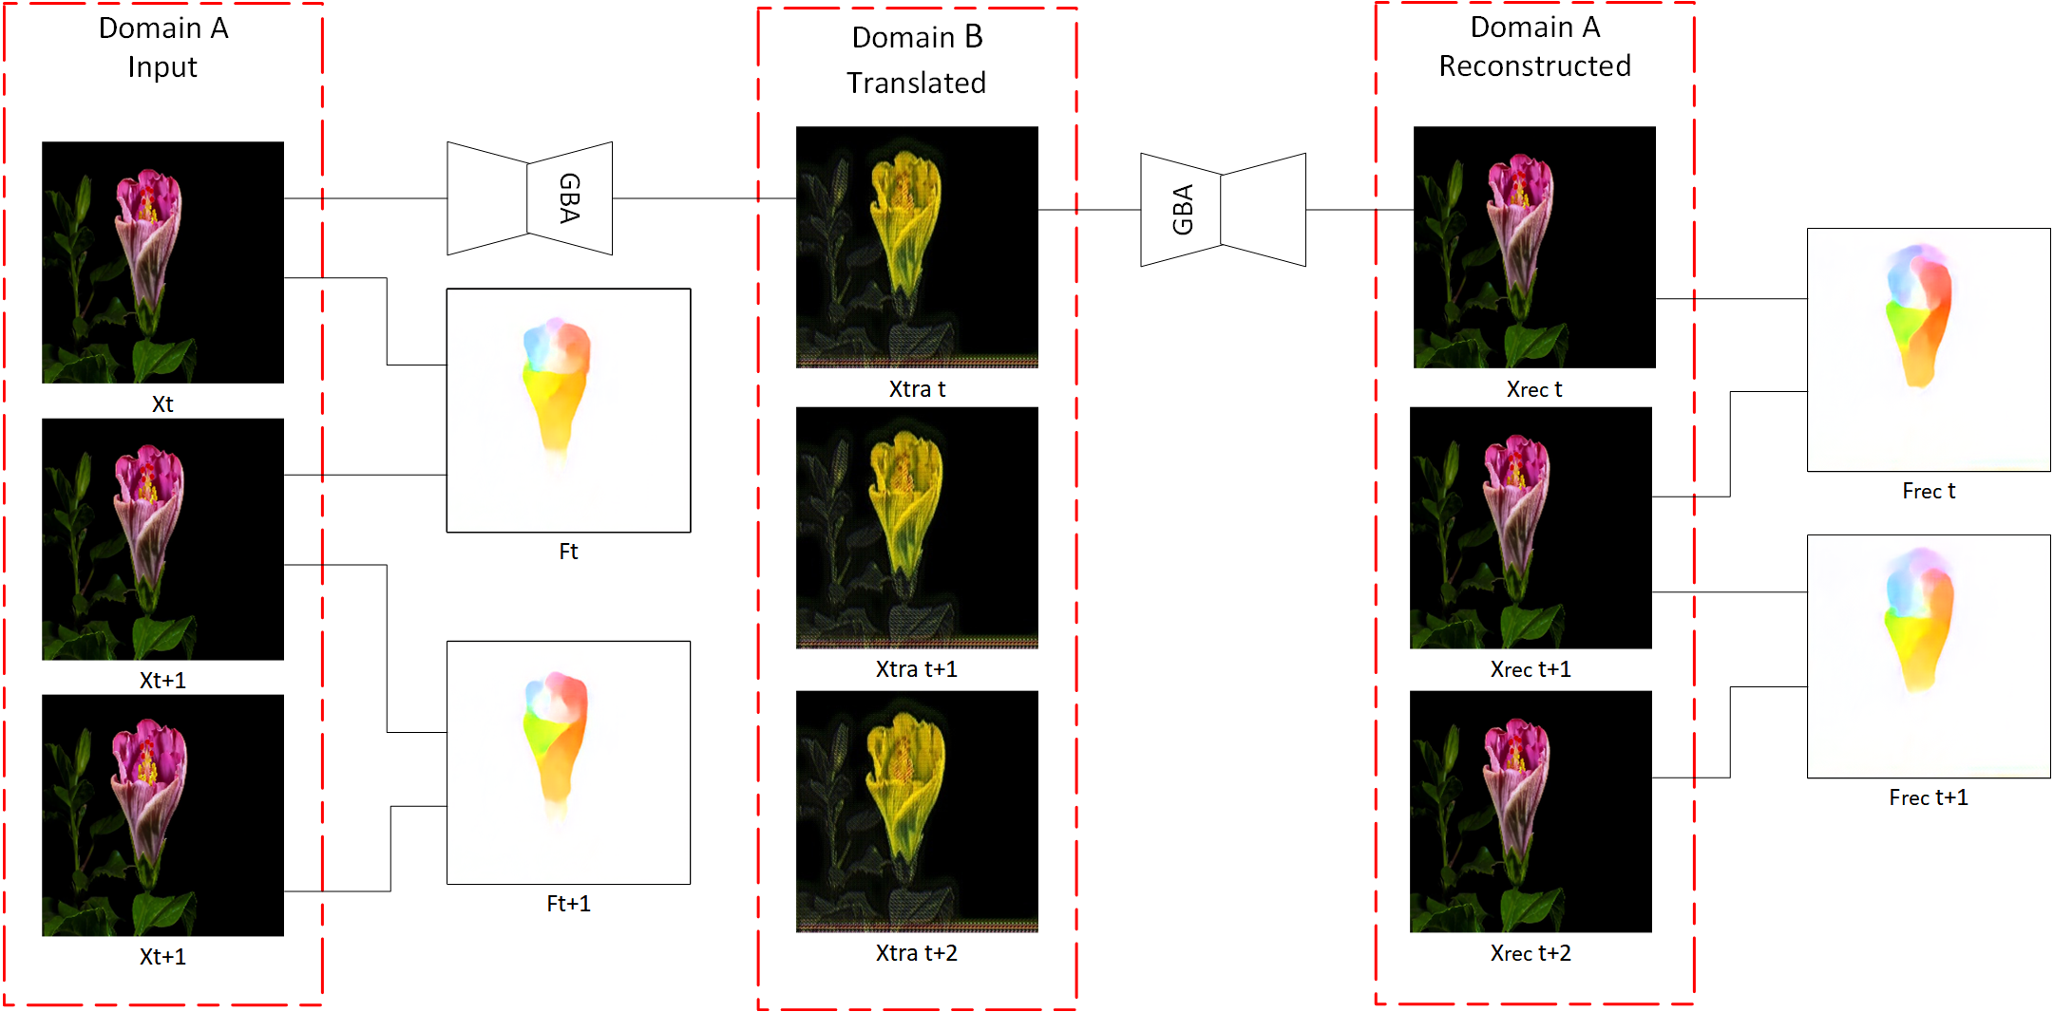
Statement of the problem
Notes:
However, currently used video-to-video translation networks, prone to object disappearance
problems, and arbitrary strange motion on the generated videos make translated videos more
unrealistic.

Slide 15
Statement of the problem
Notes:
However, currently used video-to-video translation networks, prone to object disappearance
problems, and arbitrary strange motion on the generated videos make translated videos more
unrealistic.

Slide 16
Statement of the problem
Notes:
However, currently used video-to-video translation networks, prone to object disappearance
problems, and arbitrary strange motion on the generated videos make translated videos more
unrealistic.

Slide 17
Statement of the problem
Notes:
However, currently used video-to-video translation networks, prone to object disappearance
problems, and arbitrary strange motion on the generated videos make translated videos more
unrealistic.

Slide 18
Statement of the problem
Research Question
Can adding additional constraints improve temporal coherency for video translation?
What is the effect of temporal discriminator on improving unsupervised video-to-video translation?
Notes:
However, currently used video-to-video translation networks, prone to object disappearance
problems, and arbitrary strange motion on the generated videos make translated videos more
unrealistic.

Slide 19
Objective of the Study
General Objective
The general objective of the study is to incorporate a temporal cycle consistency constraint for video-to-video translation to the ReCycle GAN network.
Specific Objective
Gathering dataset for training and testing.
Embedding feature preserving loss to Cycle GAN
Modifying the discriminator network to make it aware of temporal information.
Adding learning constraints to the Cycle GAN and ReCycle GAN networks.
Designing a GAN model for the video translation using the TensorFlow Keras framework.
Evaluating the performance of the model.
Notes:
However, currently used video-to-video translation networks, prone to object disappearance
problems, and arbitrary strange motion on the generated videos make translated videos more
unrealistic.

Slide 20
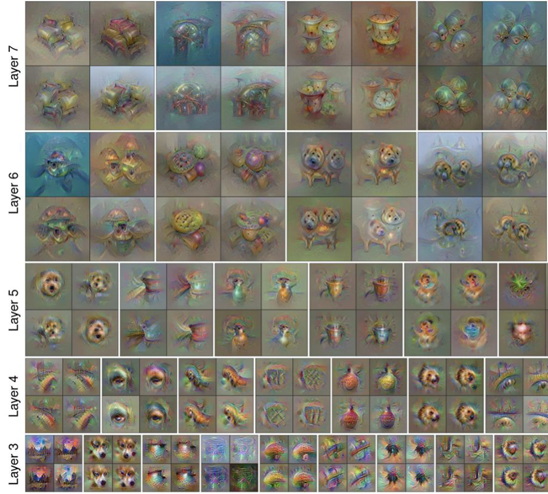
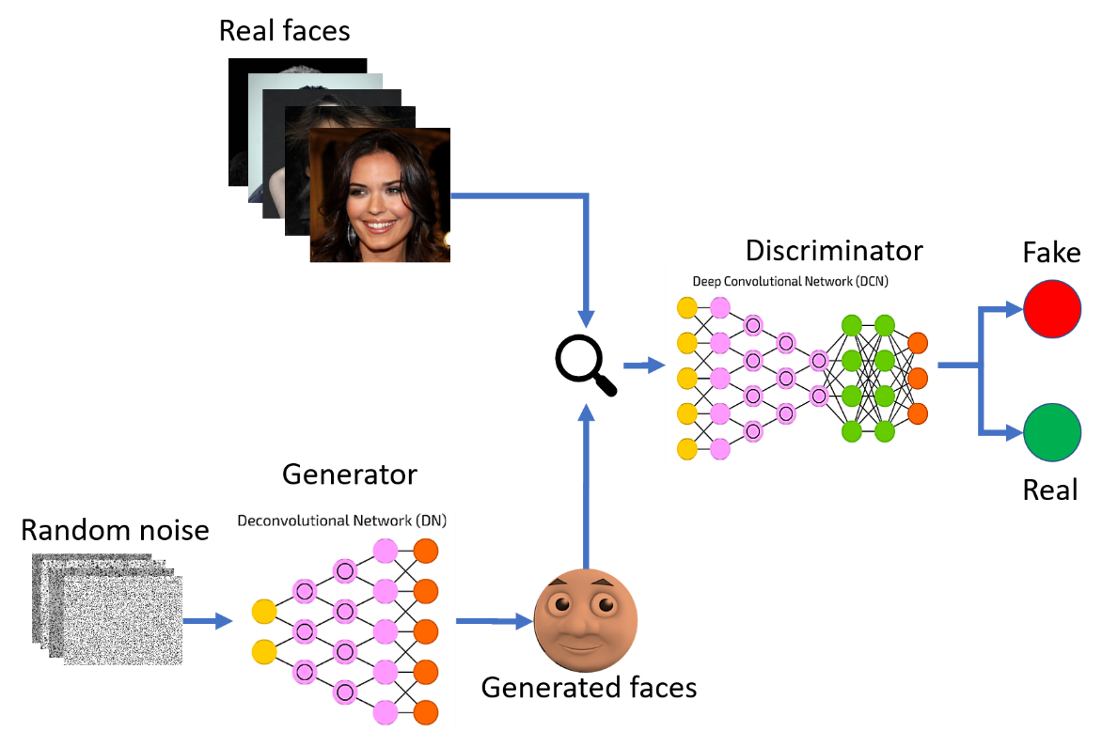
Background
Goal: Given a feature vector for an image, find a new image such that
GAN
Its features are similar to the given features
It “looks natural”

Slide 21
Literature Review
Author | Methodology | Temporal modeling | GAP
Zhu et al. 2017 | Cycle Consistency Constraint. | Doesn’t consider temporal information. | Framewise image-to-image translation.
Bashkirova et al. 2018 | 3D-Cycle Consistency Constraint | The network implicitly learns to form input video. | Fixed-length video Not complex enough for temporal learning.
Wei et al. 2018 | Cycle Consistency RNN based Discriminator. | Temporal residual error minimizer, Optical flow warping | Fail in case of fast object motion Fixed length video.
Notes:
However, currently used video-to-video translation networks, prone to object disappearance
problems, and arbitrary strange motion on the generated videos make translated videos more
unrealistic.

Slide 22
Literature Review
Author | Methodology | Temporal modeling | GAP
Chen et al. 2019 | Cycle GAN Motion translator-based motion cycle consistency. | Motion translator network | No content translation.
Bansal et al. 2018 | Recurrent Temporal predictor Cycle-GAN | Next frame prediction. | No content translation. Temporal predictor error
Park et al. 2019 | Cycle Consistency Flow estimator network Consistency warping network | Bidirectional mapping | Input domain videos shall have very similar content
Notes:
However, currently used video-to-video translation networks, prone to object disappearance
problems, and arbitrary strange motion on the generated videos make translated videos more
unrealistic.

Slide 23
Scope
Scope and Limitation
Limitation
Translate a given domain video to another domain.
Add learning constraints to Cycle-GAN and the ReCycle-GAN network.
Blend spatial-temporal information.
One to many video-to-video translations
The video does not zoom in or out throughout the whole process.
This work does not consider the object occlusion problem.
Notes:
However, currently used video-to-video translation networks, prone to object disappearance
problems, and arbitrary strange motion on the generated videos make translated videos more
unrealistic.

Slide 24
Datasets
Research Methodology
Obama-trump
Viper dataset and
Flowers are used for both training and testing stages as used in ReCycle GAN work.
Adiss( አዲስ) - Prime minister Abiy Ahmed and Debretsion Gebremichael
3-minute video from the internet has been used.
5000 images and the frame size is 256 x 256.
Notes:
However, currently used video-to-video translation networks, prone to object disappearance
problems, and arbitrary strange motion on the generated videos make translated videos more
unrealistic.

Slide 25
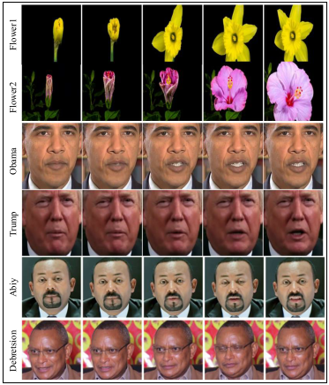
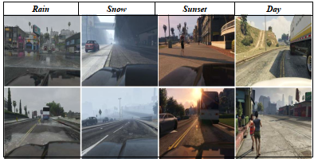
Dataset Sample
Viper dataset sample
Training dataset sample

Slide 26
Research Methodology Cont..
Baselines: To validate this study model effectiveness, the implemented model is equated with
Cycle GAN
ReCycle GAN
Temporal Discriminator Network: An ablation study has been conducted to decide the number of frames the discriminator network should consider.
Feature Extraction Network: Tan et al. 2019 EfficientNet–B7
Small parameters
Better accuracy

Slide 27
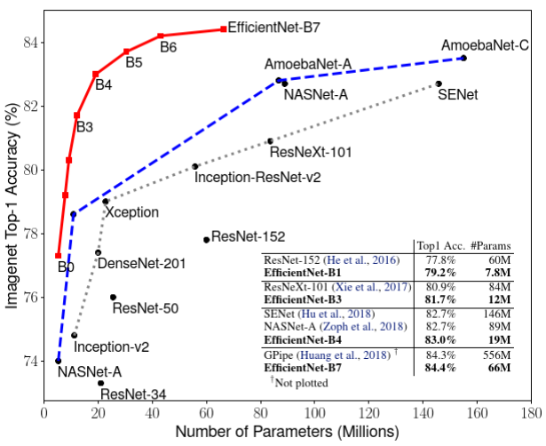
Research Methodology Cont..

Slide 28
Evaluation Methods
Research Methodology Cont..
Inception Score
Human Evaluation Study
Measures the variety of the generated images
Measures the quality of the generated images.
10 to 15 volunteers per experiment.
This study use two protocols (P1, P2)
P1 answer how good the generated video.
P2 quality of the generated and how realistic the translation is compared to the original input video

Slide 29
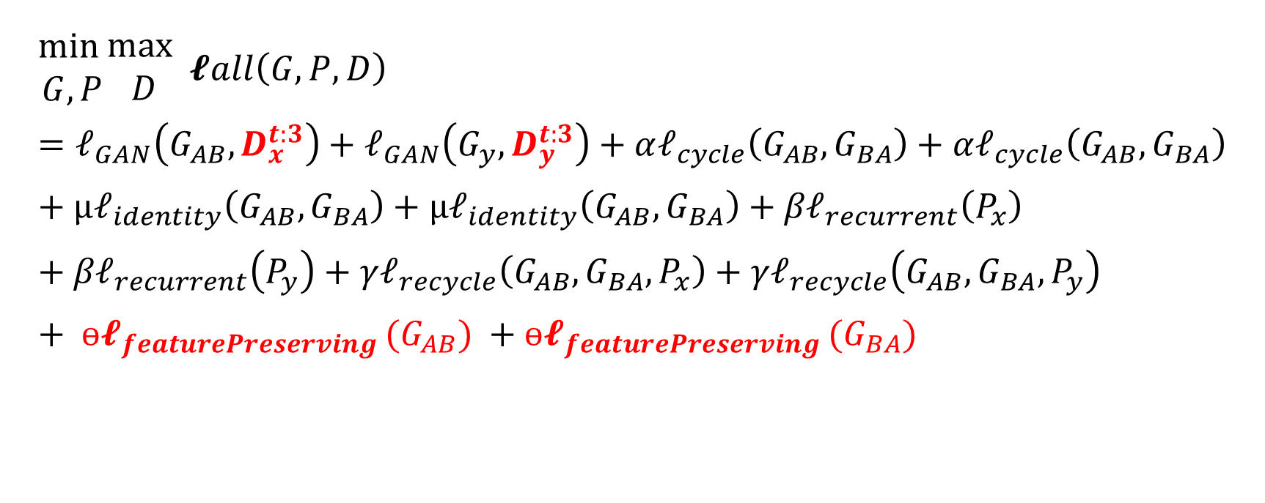
Proposed Learning Function
$$\begin{matrix}min \\ G, P\end{matrix}\begin{matrix}max \\ D\end{matrix} 𝓵all\left(G, P, D\right)=𝓁_{GAN}\left(G_{AB},D_{x}^{t:3}\right)+𝓁_{GAN}\left(G_{y},D_{y}^{t:3}\right)+α𝓁_{cycle}\left(G_{AB},G_{BA}\right)+α𝓁_{cycle}\left(G_{AB},G_{BA}\right)+μ𝓁_{identity}\left(G_{AB},G_{BA}\right)+μ𝓁_{identity}\left(G_{AB},G_{BA}\right)+{β𝓁}_{recurrent}\left(P_{x}\right)+{β𝓁}_{recurrent}\left(P_{y}\right)+γ𝓁_{recycle}\left(G_{AB},G_{BA},P_{x}\right)+γ𝓁_{recycle}\left(G_{AB},G_{BA},P_{y}\right)+ ɵ𝓵_{featurePreserving }(G_{AB}) +ɵ𝓵_{featurePreserving }(G_{BA})$$

Slide 30
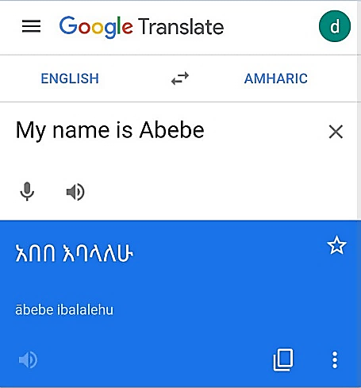
Cycle Loss
Proposed Learning Function
to learn bidirectional mapping in the absence of paired training data.
$${\begin{matrix}min \\ G_{AB},G_{BA}\end{matrix}L}_{cyc}\left(G_{AB},G_{BA}\right)=\sum_{t}{\left[\left[{\left\|G_{BA}\left(G_{AB}\left(x\right)\right)−x\right\|}_{1}\right]+ \left[{\left\|G_{AB}\left(G_{BA}\left(y\right)\right)−y\right\|}_{1}\right]\right]}$$
The loss of the network in this instance would be the difference between “ስም አበበ ይባላል” and “አበበ እባላለሁ”.
Notes:
Classic Cycle-Consistency does not essentially assurance the transformation to be semantically consistent.

Slide 31
Identity Loss
Proposed Learning Function
identity loss ensures that the network retains the overall color structure of the image.
$$\begin{matrix}min \\ G_{AB},G_{BA}\end{matrix}L_{identity}\left(G_{AB},G_{BA}\right)=\sum_{t}{ \left[{\left\|G_{AB}\left(x\right)−x\right\|}_{1}\right]+ \left[{\left\|G_{BA}\left(y\right)−y\right\|}_{1}\right]}$$
Notes:
Classic Cycle-Consistency does not essentially assurance the transformation to be semantically consistent.

Slide 32
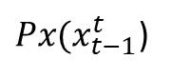
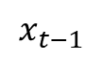
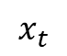
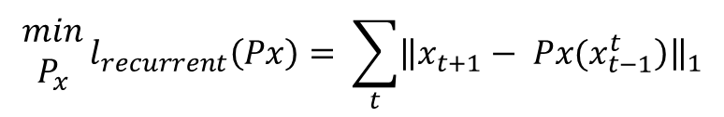
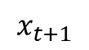
Recurrent Loss
Proposed Learning Function
A predictor to predict frames in the future based on the past frame.
$$x_{t}$$
$Px(x_{t−1}^{t}$)
$$x_{t−1}$$
$$x_{t+1}$$
$$\begin{matrix}min \\ P_{x}\end{matrix}{l_{recurrent}\left(Px\right)= \sum_{t}{{\left\|\left.x_{t+1}− Px(x_{t−1}^{t}\right)\right\|}_{1}}}$$
Notes:
Classic Cycle-Consistency does not essentially assurance the transformation to be semantically consistent.

Slide 33

Recycle Loss
Proposed Learning Function
A predictor to predict frames in the future based on the past frame.
$$\begin{matrix}min \\ P_{x}G_{y}P_{y},\end{matrix}{l_{recycle}\left({{G_{x},G}_{y},P}_{x}\right)= \sum_{t}{{\left\|\left.x_{t+1}− {G_{x}(P}_{y}(G_{y}(x_{t−1}^{t}))\right)\right\|}_{1}}}$$
Notes:
Classic Cycle-Consistency does not essentially assurance the transformation to be semantically consistent.

Slide 34
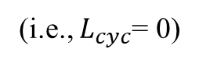
Feature Preserving Loss
Proposed Learning Function
Classic Cycle-Consistency does not essentially assurance the transformation to be semantically consistent.
(i.e., $L_{cyc}$= 0)
አበበ እባላለሁ
My name is Abebe
My name is Abebe
አንተ አበበ ነኝ
Notes:
Classic Cycle-Consistency does not essentially assurance the transformation to be semantically consistent.

Slide 35
Feature Preserving Loss
Proposed Learning Function
Classic Cycle-Consistency does not essentially assurance the transformation to be semantically consistent.
(i.e., $L_{cyc}$= 0)
አበበ እባላለሁ
My name is Abebe
My name is Abebe
አንተ አበበ ነኝ
$$\begin{matrix}min \\ G_{AB},G_{BA}\end{matrix}L_{Fpreserving}\left(G_{AB},G_{BA}\right)= \sum_{t}{\left[\left[{\left\|mNET\left(G_{AB}\left(x\right)\right)−mNET\left(x\right)\right\|}_{1}\right]+ \left[{\left\|mNET\left(G_{BA}\left(y\right)\right)−mNET\left(y\right)\right\|}_{1}\right]\right]}$$
Notes:
Classic Cycle-Consistency does not essentially assurance the transformation to be semantically consistent.

Slide 36
Feature Preserving Loss
Proposed Learning Function
Classic Cycle-Consistency does not essentially assurance the transformation to be semantically consistent.
(i.e., $L_{cyc}$= 0)
$$\begin{matrix}min \\ G_{AB},G_{BA}\end{matrix}L_{Fpreserving}\left(G_{AB},G_{BA}\right)= \sum_{t}{\left[\left[{\left\|mNET\left(G_{AB}\left(x\right)\right)−mNET\left(x\right)\right\|}_{1}\right]+ \left[{\left\|mNET\left(G_{BA}\left(y\right)\right)−mNET\left(y\right)\right\|}_{1}\right]\right]}$$
mNET stands for a pre-trained EfficientNet-B7 feature extractor.
Notes:
Classic Cycle-Consistency does not essentially assurance the transformation to be semantically consistent.

Slide 37
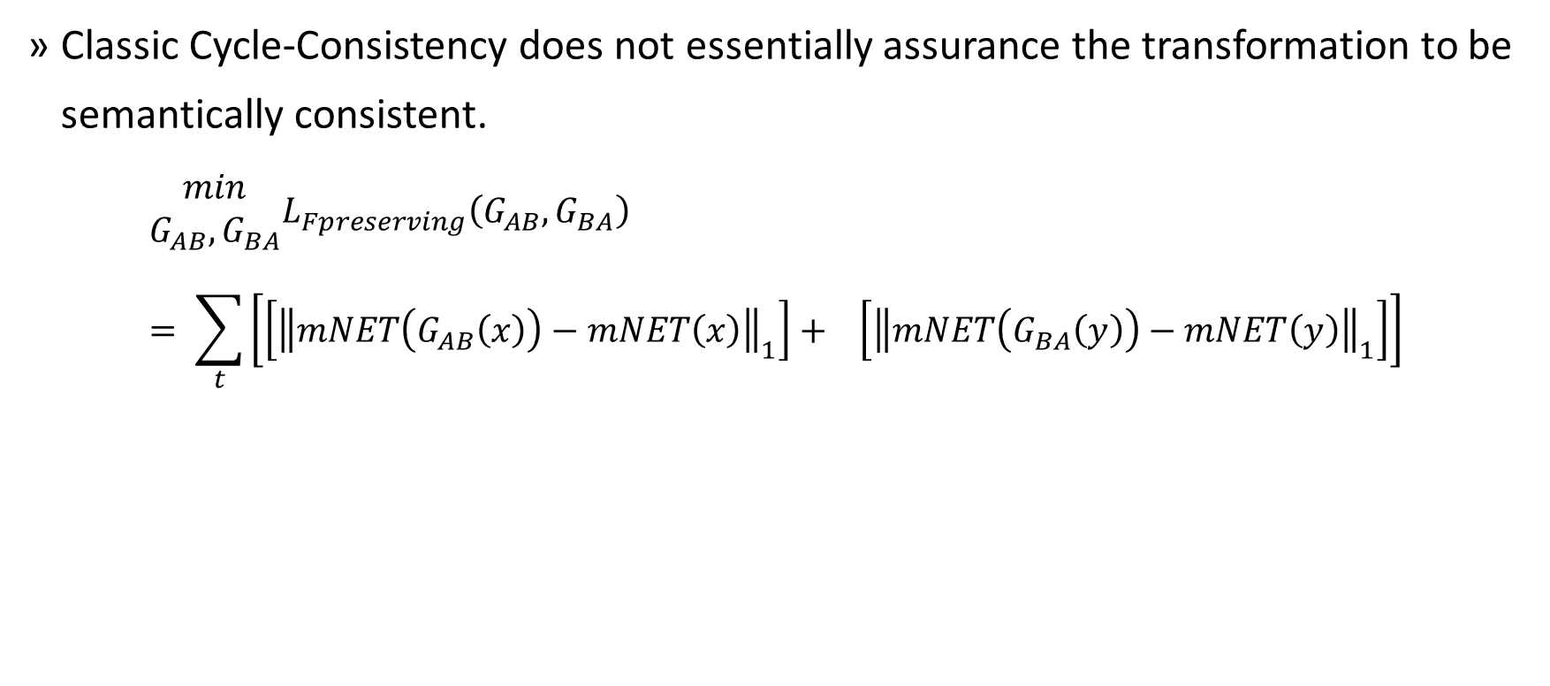
Feature Preserving Loss
Proposed Learning Function
Classic Cycle-Consistency does not essentially assurance the transformation to be semantically consistent.
$$\begin{matrix}min \\ G_{AB},G_{BA}\end{matrix}L_{Fpreserving}\left(G_{AB},G_{BA}\right)= \sum_{t}{\left[\left[{\left\|mNET\left(G_{AB}\left(x\right)\right)−mNET\left(x\right)\right\|}_{1}\right]+ \left[{\left\|mNET\left(G_{BA}\left(y\right)\right)−mNET\left(y\right)\right\|}_{1}\right]\right]}$$
Notes:
Classic Cycle-Consistency does not essentially assurance the transformation to be semantically consistent.

Slide 38
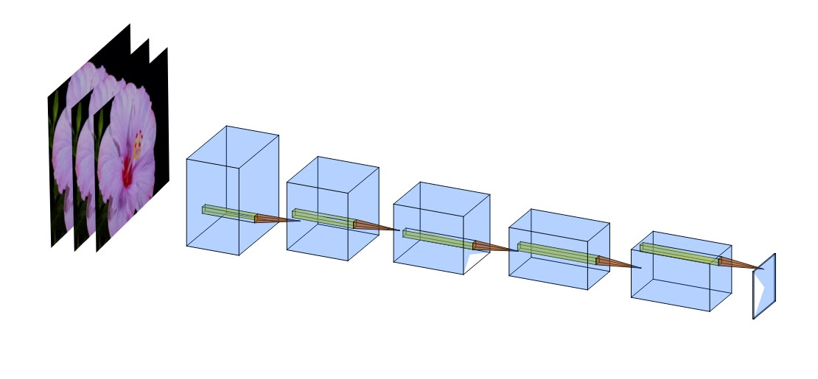
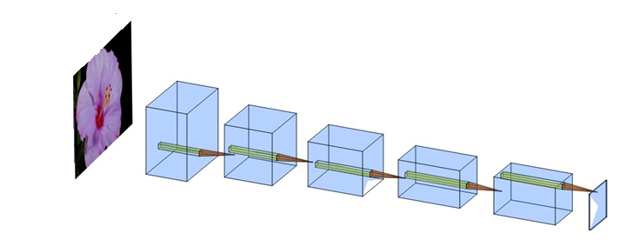
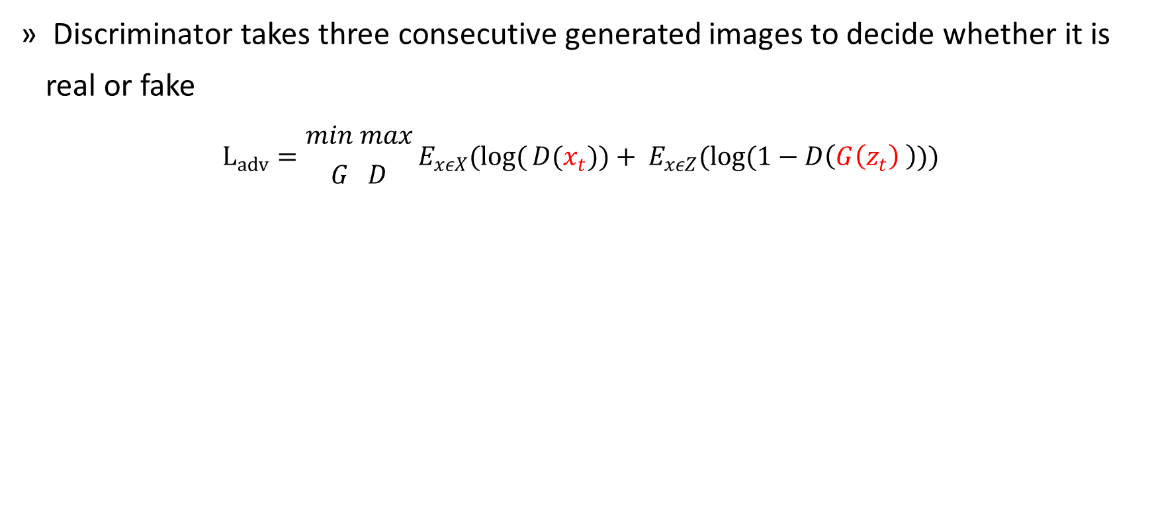
Temporal Discriminator
Proposed Learning Function
Discriminator takes three consecutive generated images to decide whether it is real or fake
$$L_{adv}={min max \atop G D}E_{xεX}(log({D(x_{t}}))+ E_{xεZ}(log(1−D\left(G\left(z_{t}\right) \right)))$$
Notes:
Rather than differentiating between single frames, the discriminator network is designed in a way to observes three constitutive of synthesized frames and three constitutive of the real frames.

Slide 39
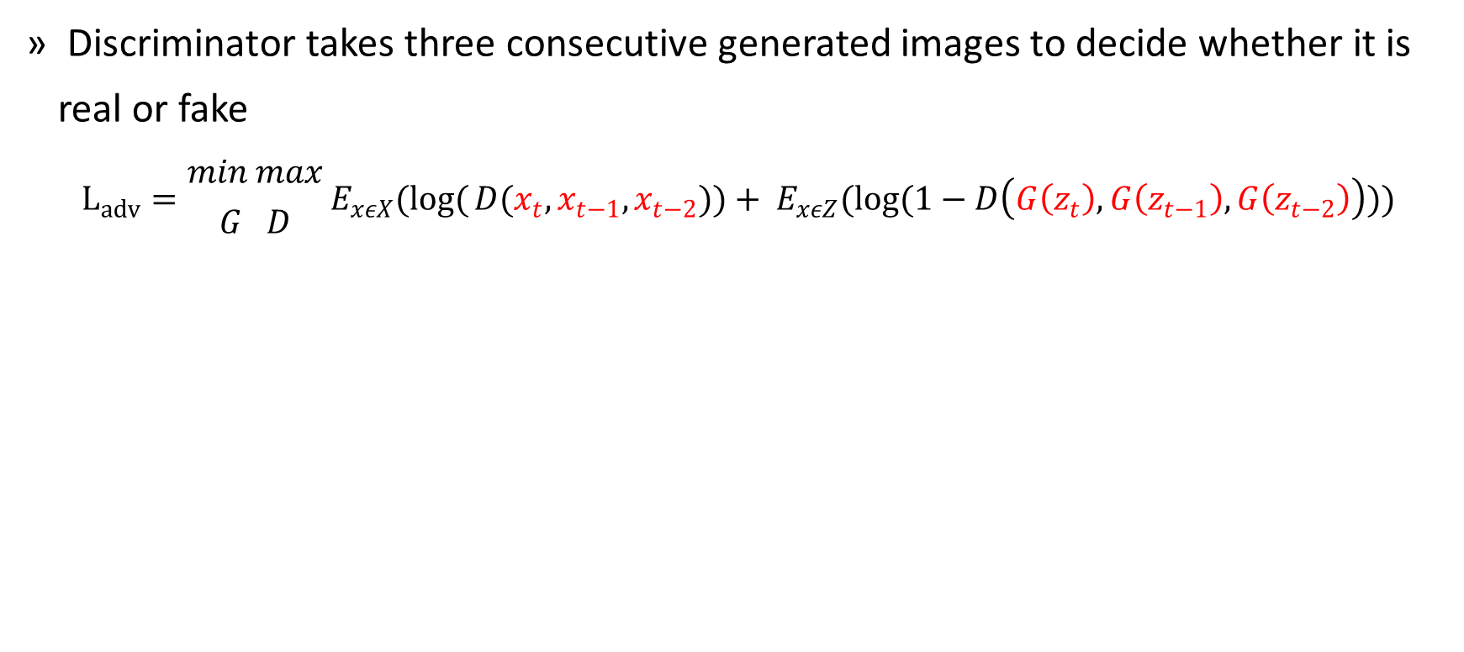
Temporal Discriminator
Proposed Learning Function
Discriminator takes three consecutive generated images to decide whether it is real or fake
$$L_{adv}={min max \atop G D}E_{xεX}(log({D(x_{t}, x_{t−1},x_{t−2}}))+ E_{xεZ}(log(1−D\left(G\left(z_{t}\right),G\left(z_{t−1}\right),G\left(z_{t−2}\right)\right)))$$
Notes:
Rather than differentiating between single frames, the discriminator network is designed in a way to observes three constitutive of synthesized frames and three constitutive of the real frames.

Slide 40
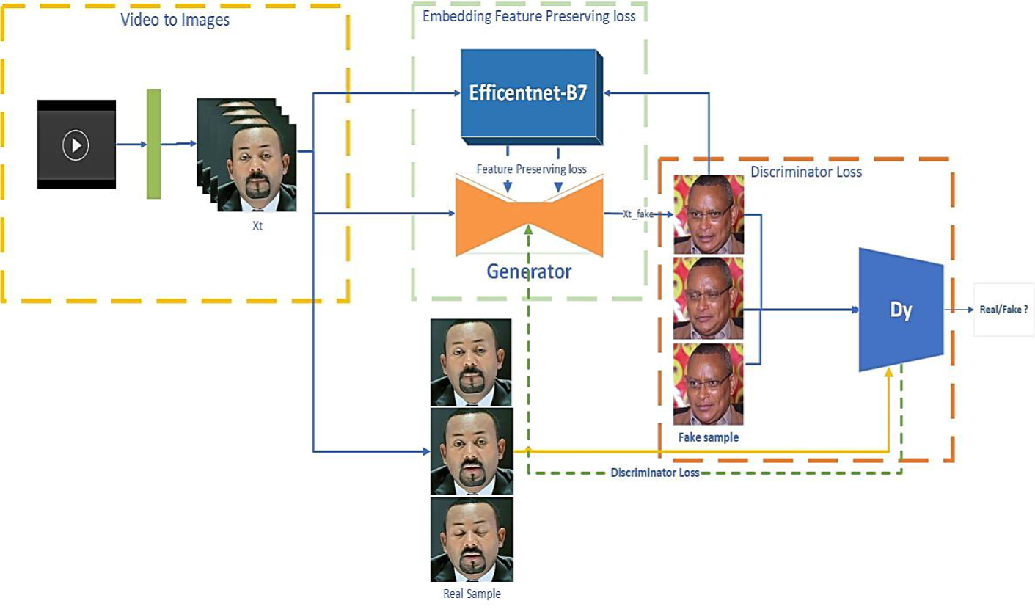
Model Architecture
Proposed Learning Function

Slide 41
Model Architecture
Proposed Learning Function

Slide 42
Model Architecture
Proposed Learning Function

Slide 43
Model Architecture
Proposed Learning Function

Slide 44
Model Architecture
Proposed Learning Function

Slide 45
Model Architecture
Proposed Learning Function

Slide 46
Experiment Class
Notation | Experiment | Epochs | Dataset | Model used
CC | Baseline CycleGAN | 200 epochs, 20 epochs | Flower dataset and Viper dataset | Cycle-GAN
CC+CP | CycleGAN with feature preserving loss | 200 epochs, 20 epochs | Flower dataset and Viper dataset | Cycle-GAN and EfficientNet-B7
CC+CP+TD | Cycle GAN with feature preserving loss and temporal discriminator Network | 200 epochs, 20 epochs | Flower dataset and Viper dataset | Cycle-GAN, Temporal aware discriminator.
RC | Baseline ReCycle-GAN | 30 epochs | Obama trump dataset and Adiss Dataset | ReCycle-GAN
RC+TD | ReCycle-GAN with temporal Discriminator | 30 epochs | Obama trump dataset and Adiss Dataset | ReCycle-GAN & temporal Discriminator

Slide 47
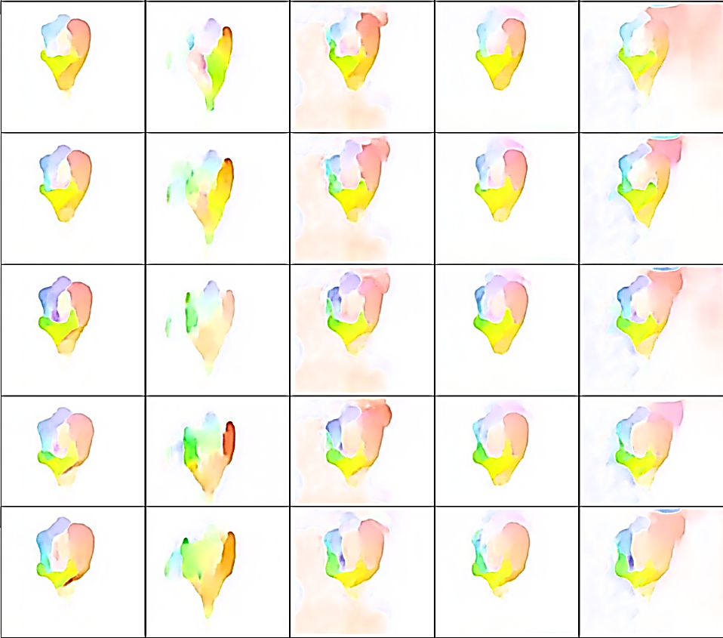
Ablation Study
Result and Discussion
Aim: come up with the number of images the discriminator network shall consider to justify output is whether real or fake?
Compare from single frame to 5 frames
5 frame discriminator fail because of memory shortage.
Number of frames?
AEE = Average endpoint error = L2 norm.
Lower value indicates better performance.

Slide 48
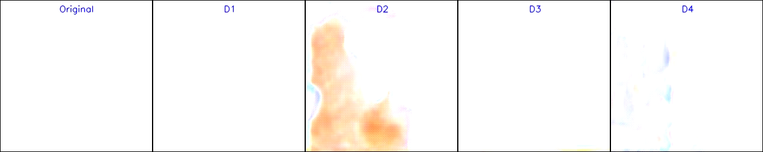

Slide 49
Flower-to-Flower
Methods | Flower
 | IS |  |  | Average Human evaluation study per domain
Real dataset |  | 1.165±0.030 | 1.248±0.055
 |  | Domain A | Domain B | Domain A | Domain B
CC |  | 1.022±0.002 | 1.102±0.031 | 25% | 3.1%
CC + CP |  | 1.023±0.009 | 1.122±0.184 | 9.4% | 0%
CC + CP + TD |  | 1.138±0.041 | 1.162±0.025 | 65.6% | 96.9%

Slide 50
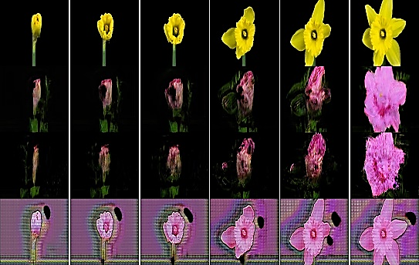
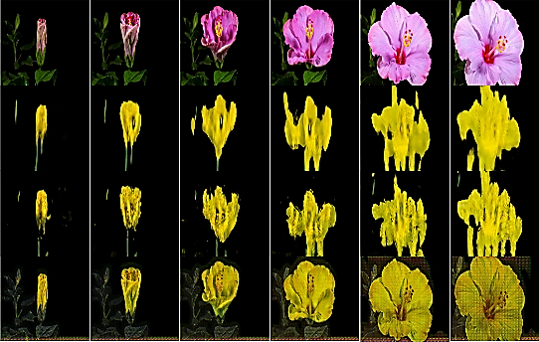

Slide 51

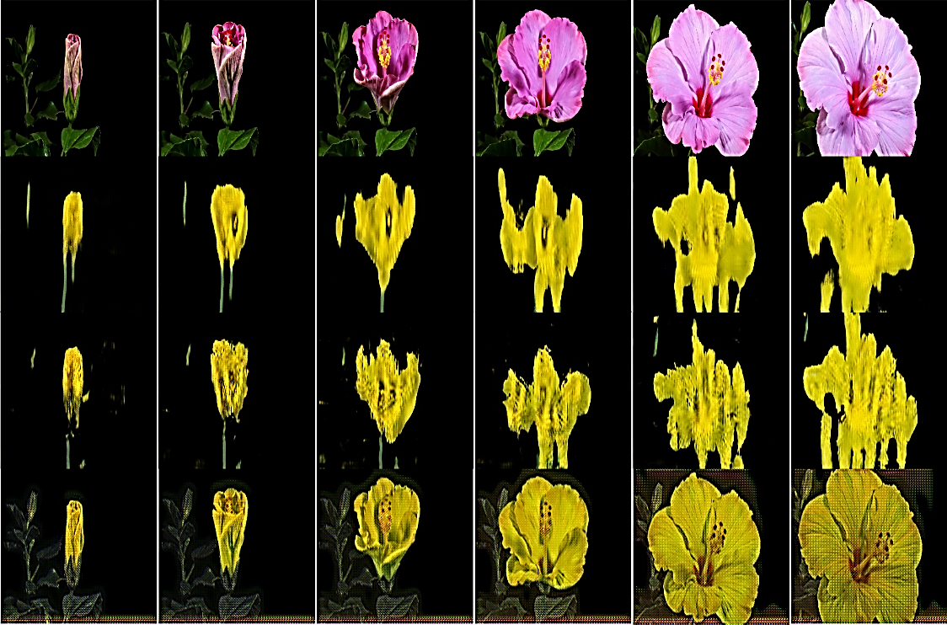
1st row Input, 2nd row CC, 3rd row CC+CP, 4th row CC+CP+TD

Slide 52
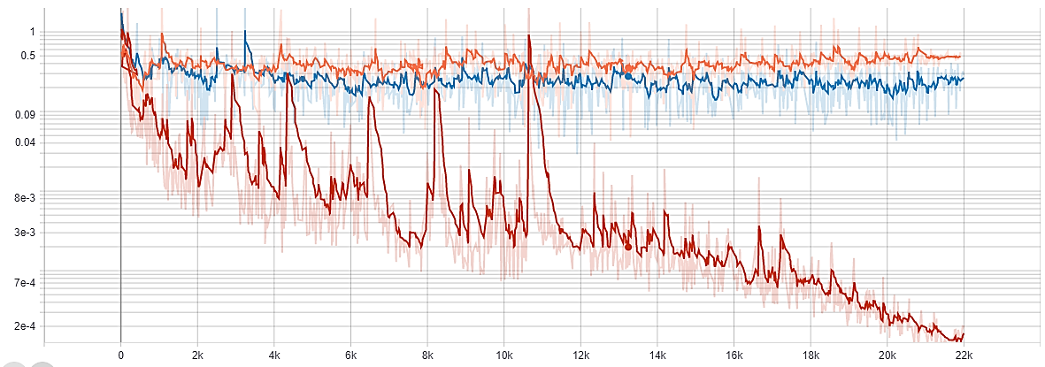
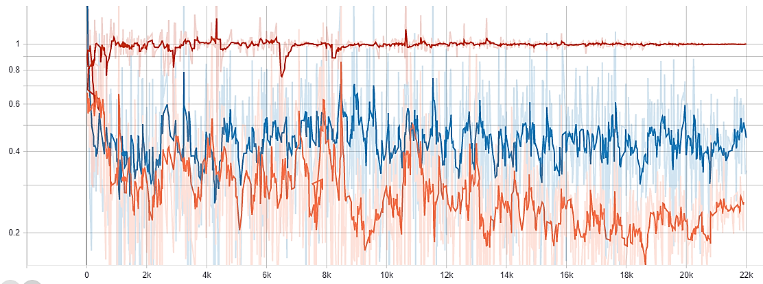
Discriminator loss
Generator loss
(Red): CC+CP+TD, (blue): CC+CP, (orange): CC. The CC+CP+TD discriminator loss quickly fails to zero results the generator loss to explode to one.

Slide 53
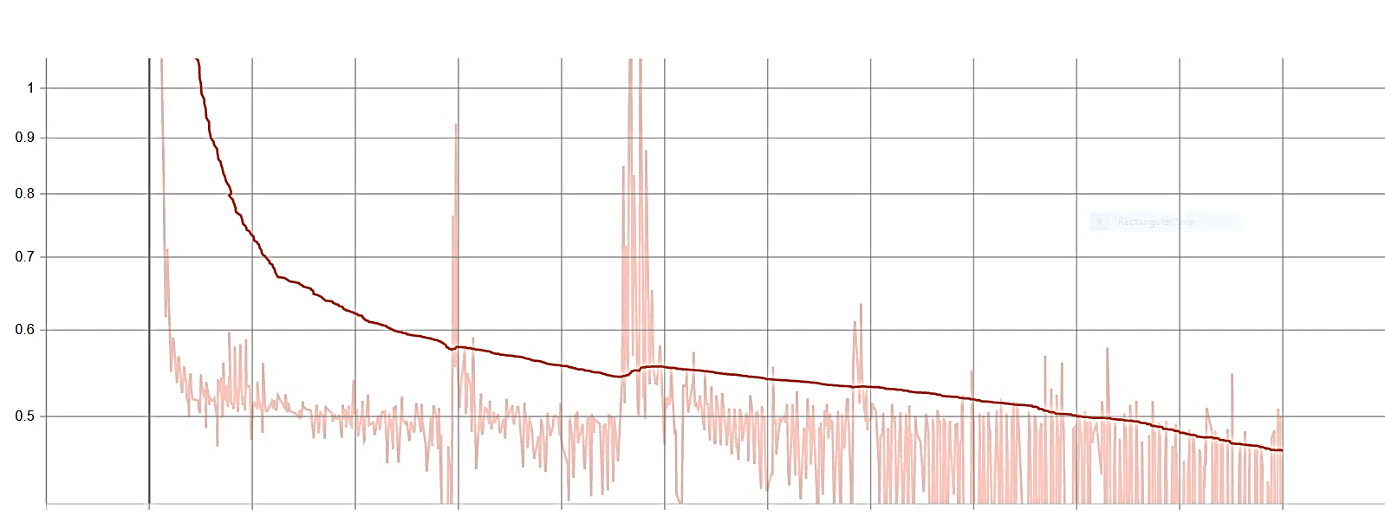
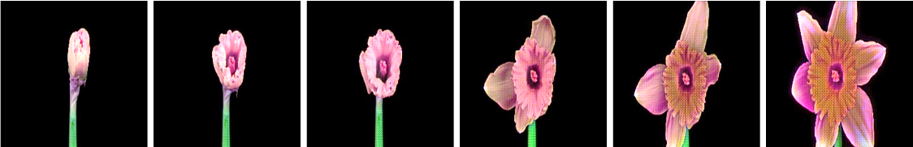
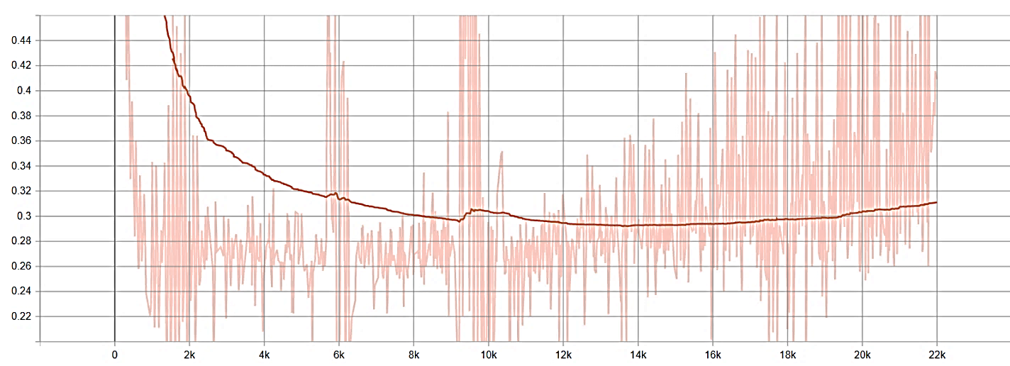
Output sample
(Top) generator loss, and (bottom) discriminator loss

Slide 54
Day-to-Sunset
Methods | Day to Sunset
 | IS |  |  | Average Human evaluation study per domain
Real dataset |  | 3.56s±0.21 | 3.81±0.44
 |  | Day | Sunset | Day | Sunset
CC |  | 2.50±0.17 | 2.71±0.19 | 0% | 5%
CC + CP |  | 3.09±0.07 | 3.64±0.26 | 40% | 40%
CC + CP + TD |  | 3.23±0.13 | 3.61±0.11 | 60% | 55%
Bold values indicate the best results in the experiments.

Slide 55
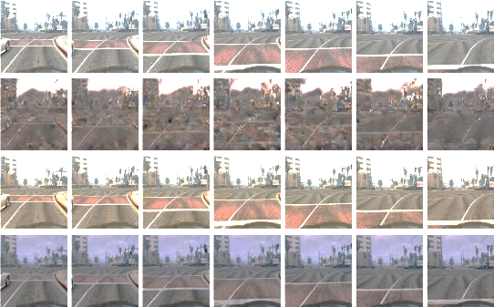
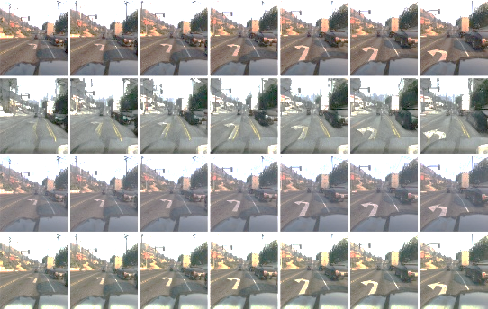

Slide 56
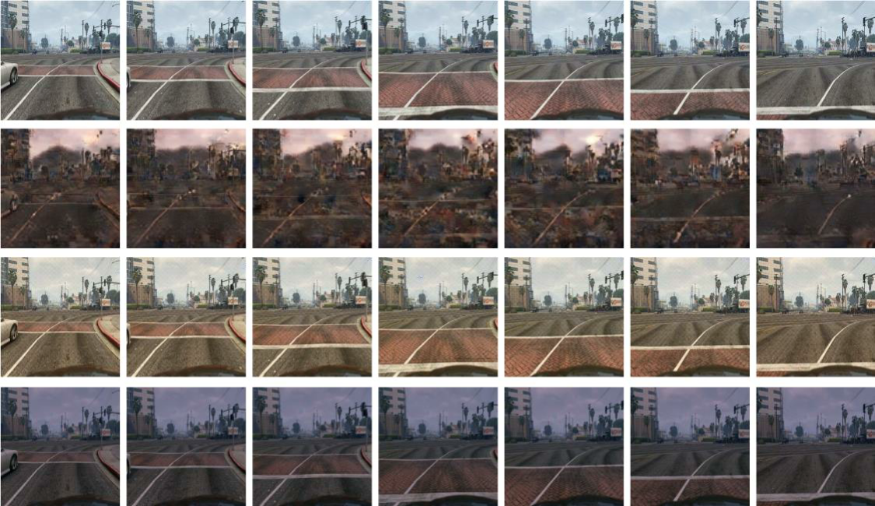
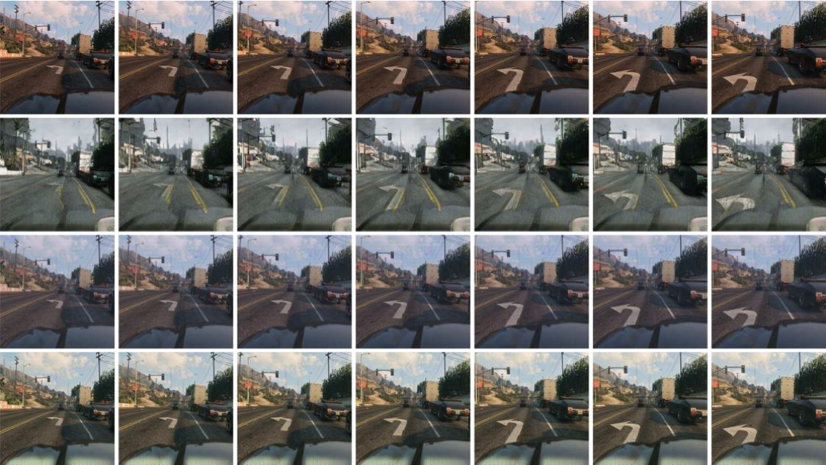

Slide 57
Day-to-Sunset
CC+CP performs much better in the sunset-to-day datasets than the flower translation.
Efficientnet-B7 train on ImageNet (ImageNet doesn’t have substantial flower blooming instance)
CC+CP+TD impacted by the vanishing of the gradient problem in flower dataset but Viper Dataset big enough
Introduced Constraints help the network to preserve better detail information.
Notes:
it is because the Efficientnet-B7 feature extracting network trains on ImageNet. I did not think there were substantial flower blooming (in fact it only contains 1197 images of flowers, which is around 0.0084% of the entire dataset.) instances in training so the network might not be able to extract adequate features in flower video.
CC+CP+TD was impacted by the vanishing of the gradient problem in the tiny dataset as seen in the flower to flower translation, and maybe the viper dataset is big enough as the pixelated and the artifacts problem in the flower translation has diminished even better.

Slide 58
Green
Yellow
Red
(Left) input images, (center) Cycle-GAN, (right) this thesis work, CC+CP+TD

Slide 59
Trump-to-Obama
Both RC and RC+TD can capture facial gesture.
Methods | Day to Sunset
 | IS |  |  | Average Human evaluation study per domain
Real dataset |  | 1.283±0.102 | 1.069±0.274
 |  | Obama | Trump | Obama | Trump
RC |  | 1.035±0.120 | 1.048±0.010 | 40% | 20%
RC + TD |  | 1.041±0.013 | 1.068±0.011 | 60% | 80%
Notes:
The IS result shows this thesis work ReCycle-GAN with temporal discriminator (RC+TD) advantages over ReCycle-GAN(RC)

Slide 60
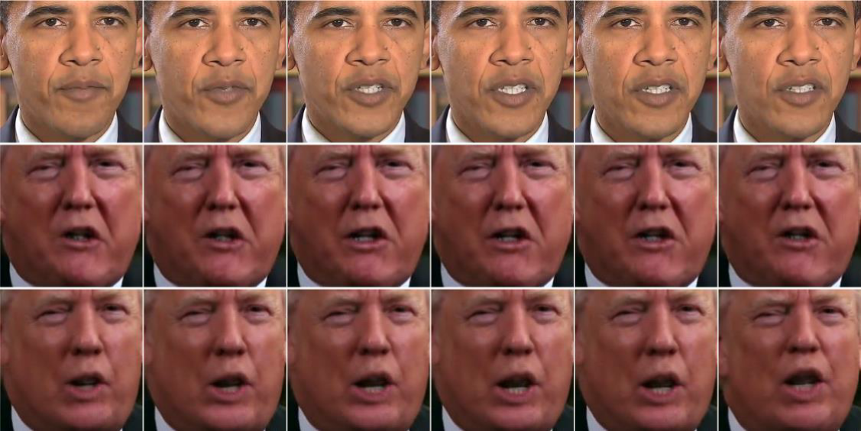
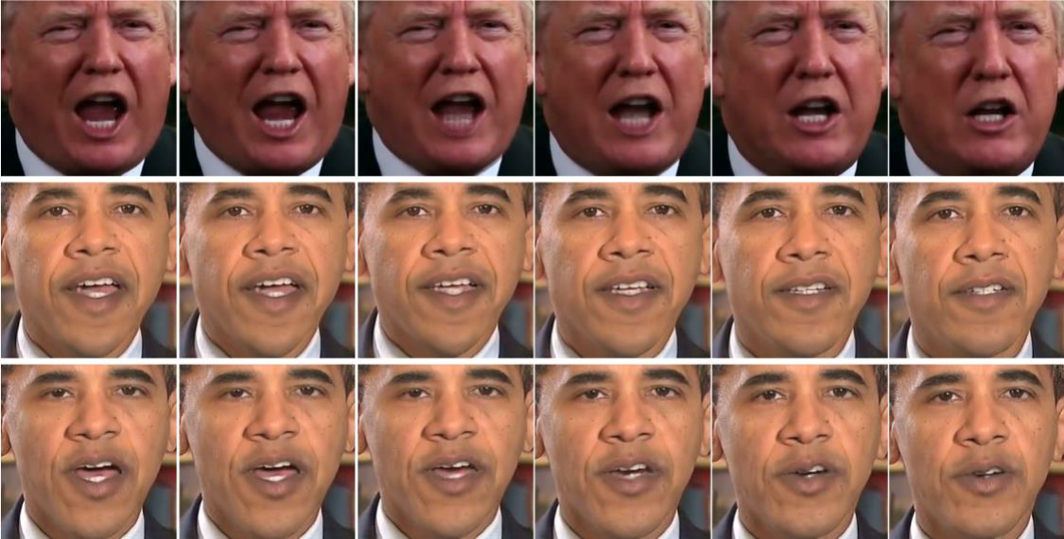
Trump-to-Obama
Notes:
The IS result shows this thesis work ReCycle-GAN with temporal discriminator (RC+TD) advantages over ReCycle-GAN(RC)

Slide 61
Trump-to-Obama
Notes:
The IS result shows this thesis work ReCycle-GAN with temporal discriminator (RC+TD) advantages over ReCycle-GAN(RC)

Slide 62
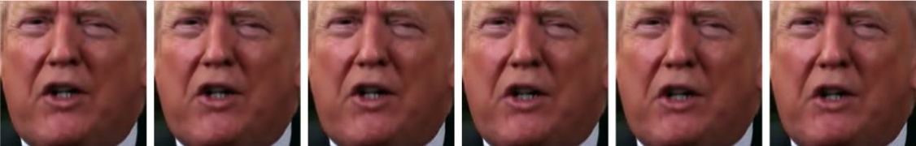
Trump-to-Obama
RC model has been suffered from image flipping problem (Problem inherited from CNN)
RC+TD could maintain input video alignment which indicates the temporal discriminator network has better orientation awareness in its model weight
Notes:
But for fair comparison in Figure 6-10, RC output images have been aligning according to the input

Slide 63
Abiy-to-Debertsion
Methods | Abiy to Debretsion
 | IS |  |  | Average Human evaluation study per domain
Real dataset |  | 1.250±0.055 | 1.475±0.047
 |  | Debretsion | Abiy | Debretsion | Abiy
RC |  | 1.171±0.054 | 1.314±0.033 | 35% | 35%
RC + TD |  | 1.218±0.030 | 1.307±0.031 | 65% | 65%
Notes:
This experiment extends face to face to implicate performance of the model on the local dataset Adiss (አዲስ) which relatively is a very complex datasets contain full face including hair, eyeglass, colorful background, and unaligned face direction

Slide 64
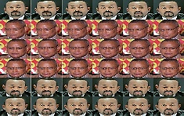
Abiy-to-Debertsion
Notes:
This experiment extends face to face to implicate performance of the model on the local dataset Adiss (አዲስ) which relatively is a very complex datasets contain full face including hair, eyeglass, colorful background, and unaligned face direction

Slide 65
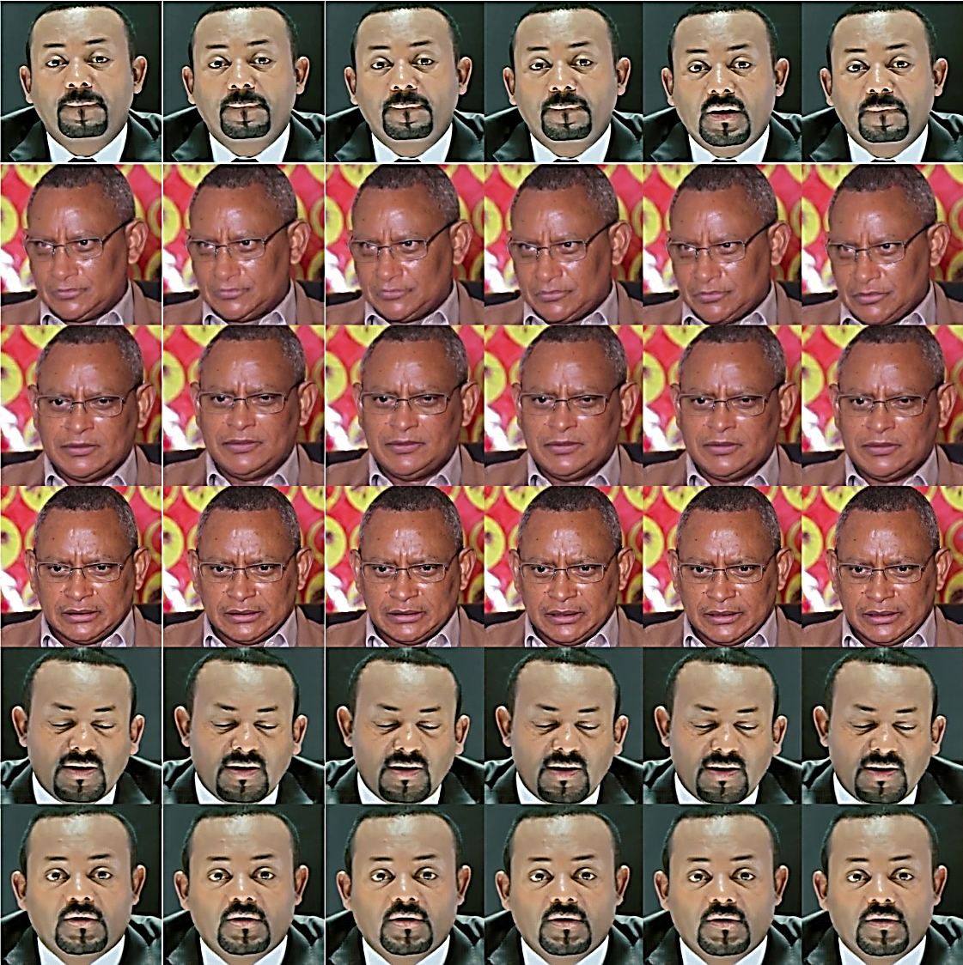
Notes:
Since the fake Abiy video result was simply recognizable as fake

Slide 66
Conclusion and Future work
Video-to-Video translation should exploited both spatial and temporal information.
Early work relay on cycle consistency for content translation but result object disappearance problem.
To mitigate object disappearance problem loss-preserving constraint introduce to minimize feature map difference between original input and translated output.
Temporal discriminator network check temporal coherency between the generate frames has been introduced to further minimize object dislocation problem.
Notes:
Different from early approaches, which focus only on the generated image, look real or fake based on Spatial information only. this approach enforces the discriminator network to emphasize not only on the spatial domain to judge real or fake but also check temporal coherency between the generated image and its preceding two frames.

Slide 67
Conclusion and Future work
Proposed model impacted by
The Efficientnet-B7 model performance on such datasets.
Dataset size (Collapse in small datasets but improved by gradient penalty).
Ablation study has been conducted to decided temporal discriminator type.
Cycle GAN is not complex enough for video translation.(with respect)
Temporal discriminator network help the network to be aware on spatial and temporal changes.
CC+CP+TD performed advantage by 60 % on CC and 35 % on CC+CP.
Notes:
Different from early approaches, which focus only on the generated image, look real or fake based on Spatial information only. this approach enforces the discriminator network to emphasize not only on the spatial domain to judge real or fake but also check temporal coherency between the generated image and its preceding two frames.

Slide 68
Future work
Retune feature extraction network (EfficientNET-B7) on the training dataset.
Better temporal discriminator network design.
Construct synthetic intermediate frames between successive frames (HFR videos)
Notes:
Rather than a simple concatenation of output images in a manner to make temporal ware, the discriminator network could be modeled in a much efficient approach using the transformer network

Slide 69
……
THANK YOU

Slide 70

What’s the message?
Don’t believe every thing you see…
Even salt looks like sugar.

Slide 71






















































Slide 72



Cycle GAN
Cycle GAN: Cycle consistency constraint
Mathematical formulation
$X=\{x\}_{t=1}^{T}$ and $Y=\{y\}_{s=1}^{S}$
$G_{AB}:X→Y$ and $G_{BA}: Y→X$
$$G_{AB}\left(x_{t}\right)=\tilde{x_{t}},$$
$$G_{BA}\left(\tilde{x_{t}}\right)=\tilde{\tilde{x_{t}}}$$
$such that$ $x_{t} ≈\tilde{\tilde{x_{t}}}$

Slide 73



ReCycle GAN
Recycle GAN = Cycle-GAN + Temporal Predictor
Mathematical formulation

